Slide 1
Holy
March 1

Slide 2
Introduction Video
View Video

Slide 3
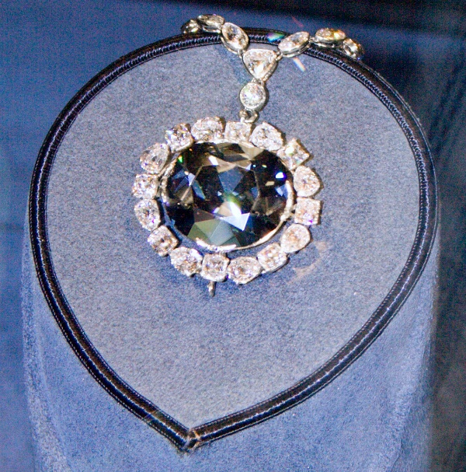
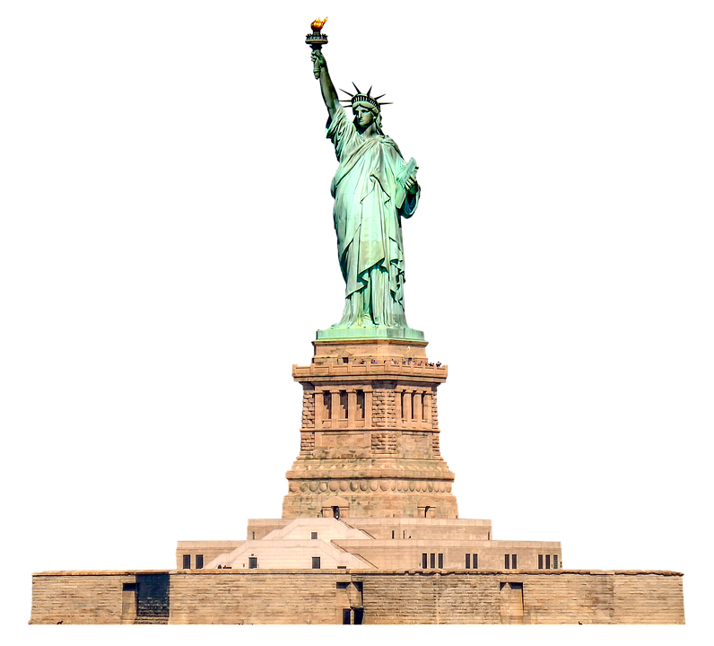
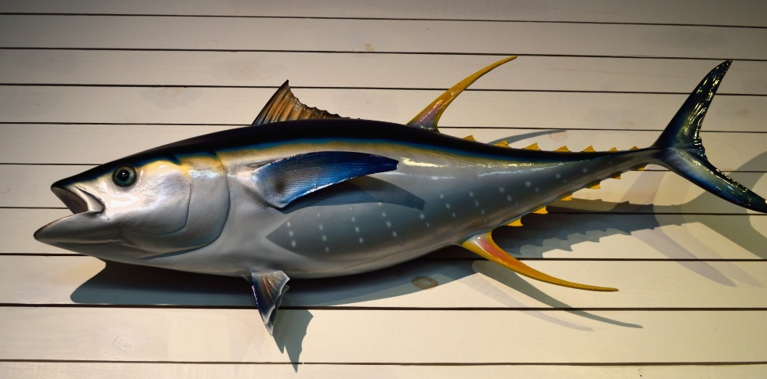
Think about it …
When have you seen something that would be considered “one of a kind”?
Our “one of a kind” examples might not all be exactly the only one in existence.
Even identical twins have differences
However God is distinct from and above absolutely everything else.
He is not just “one of a kind” … we say He is HOLY.

Slide 4
Listen for a rhetorical question.
Isaiah 40:25-26 (NIV) "To whom will you compare me? Or who is my equal?" says the Holy One. 26 Lift your eyes and look to the heavens: Who created all these? He who brings out the starry host one by one, and calls them each by name. Because of his great power and mighty strength, not one of them is missing.

Slide 5
Creator without Equal
Though stated as a question, what is the implied truth found in verse 25?
Where did Isaiah direct the readers to look to see evidence of the majesty of God?
What is some of that evidence?
How do these verses affirm that God is holy and in what way?

Slide 6
Creator without Equal
When was a time you felt in awe of our Creator?
If God created and knows the stars by name, how does that give you assurance?

Slide 7
Listen for descriptions of God’s omniscience.
Isaiah 40:27-28 (NIV) Why do you say, O Jacob, and complain, O Israel, "My way is hidden from the LORD; my cause is disregarded by my God"? 28 Do you not know? Have you not heard? The LORD is the everlasting God, the Creator of the ends of the earth. He will not grow tired or weary, and his understanding no one can fathom.

Slide 8
Knowledge without Equal
Which of the people’s complaints did the prophet challenge?
Why did he suggest the people ought to know better?
What are some attributes of God the prophet mentioned to remind them of the greatness of God?

Slide 9
Knowledge without Equal
How would each attribute help them overcome the doubts stated in verse 27?
How do these verses affirm that God is holy and in what way?
When have you felt that God was unaware of your circumstances?
What are the practical implications of God knowing everything about us?

Slide 10
Listen for how God sustains.
Isaiah 40:29-31 (NIV) He gives strength to the weary and increases the power of the weak. 30 Even youths grow tired and weary, and young men stumble and fall; 31 but those who hope in the LORD will renew their strength. They will soar on wings like eagles; they will run and not grow weary, they will walk and not be faint.

Slide 11
Sustainer without Equal
According to these verses, what does the Lord do with His power?
What is the key to exchanging weakness for divine strength?
What analogies does the prophet use to describe the effectiveness of God’s strength within those who trust Him?

Slide 12
Sustainer without Equal
How do these verses affirm that God is holy and in what way?
What are some stumbling blocks that prevent us from trusting the Lord?
How has God proven Himself faithful in your life?

Slide 13
Application
Thank Him.
Thank God for His uniqueness and holiness.
Thank Him for His incredible power, infinite wisdom, and gracious sustaining work in your life.

Slide 14
Application
Trust Him.
Only God has the power and wisdom to save you, help you, and sustain you.
Consider any areas of life where you might have questioned Him or relied more on yourself.
Commit to trusting Him with all your life.

Slide 15
Application
Be holy.
God is holy, and He calls us to follow Him and be holy as well.
Commit to living a life set apart for Him.
Memorize 1 Peter 1:15-16: “But just as he who called you is holy, so be holy in all you do; for it is written: ‘Be holy, because I am holy’.”

Slide 16
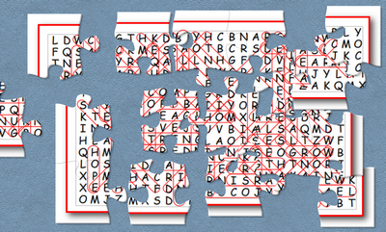
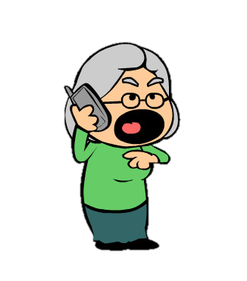
Family Activities
You’re not going to believe this. The solution to the Word Search Puzzle is a puzzle! That Word Search Lady is just getting too high handed. It’s a good thing those other activities are still available at https://tinyurl.com/wj8hcmx .
Humph!

Slide 17
Holy
March 1

