Slide 1
Growing in Christ
April 28

Slide 2
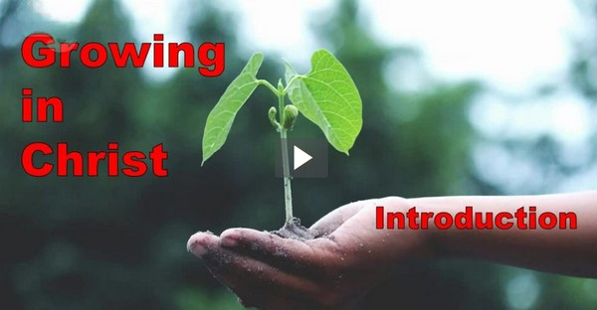
Video Introduction
View Video

Slide 3
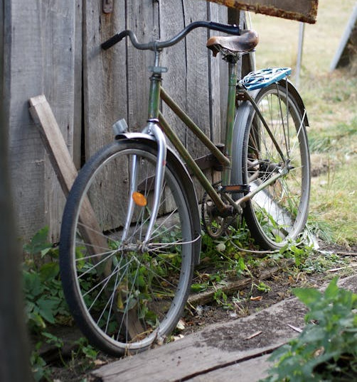
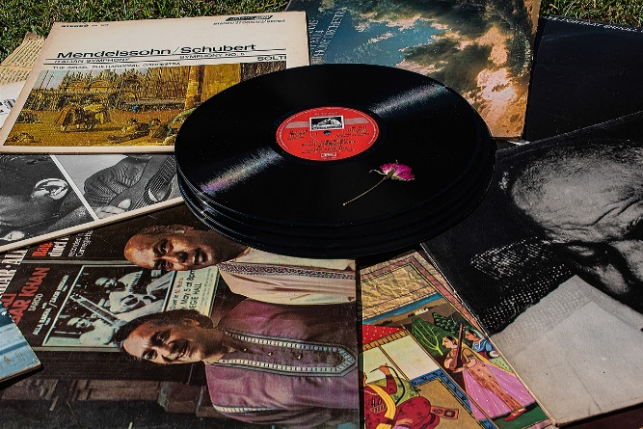
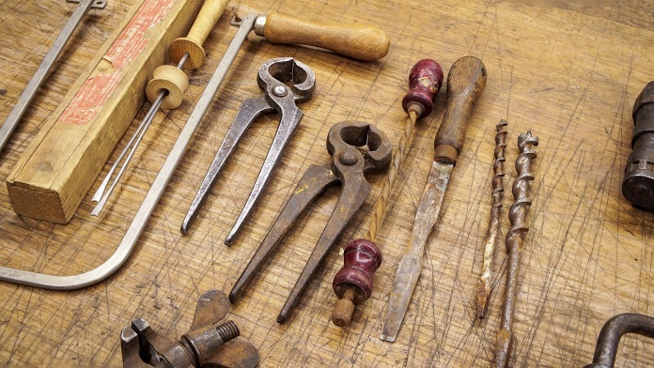
Come on … admit it …
What is something you own, but never use?
Consider that as believers, we have a personal relationship with Jesus, the very Creator of the Universe.
Do you make the most of that relationship?
We should be involved in the encouragement and building up of one another in Christ.

Slide 4
Listen for Paul’s prayer list.
Colossians 1:9-14 (NIV) For this reason, since the day we heard about you, we have not stopped praying for you and asking God to fill you with the knowledge of his will through all spiritual wisdom and understanding. 10 And we pray this in order that you may live a life worthy

Slide 5
Listen for Paul’s prayer list.
of the Lord and may please him in every way: bearing fruit in every good work, growing in the knowledge of God, 11 being strengthened with all power according to his glorious might so that you may have great endurance and patience, and joyfully 12 giving thanks to

Slide 6
Listen for Paul’s prayer list.
the Father, who has qualified you to share in the inheritance of the saints in the kingdom of light. 13 For he has rescued us from the dominion of darkness and brought us into the kingdom of the Son he loves, 14 in whom we have redemption, the forgiveness of sins.

Slide 7
Godly Character and Fruitfulness
According to verse 9, what is the focus and desire of Paul’s continued praying for the Colossians?
What can we learn about praying for others from Paul’s prayers for the Colossians?
For what things does Paul give thanks to God?
What are some ways in which our prayers are not specific?

Slide 8
Godly Character and Fruitfulness
How does praying regularly and specifically contribute to our spiritual growth?
Based on these verses, what are some specific things our group can pray for this week?

Slide 9
Listen for status with God
Colossians 1:21-23 (NIV) Once you were alienated from God and were enemies in your minds because of your evil behavior. 22 But now he has reconciled you by Christ's physical body through death to present you holy in his sight, without blemish and free

Slide 10
Listen for status with God
from accusation-- 23 if you continue in your faith, established and firm, not moved from the hope held out in the gospel. This is the gospel that you heard and that has been proclaimed to every creature under heaven, and of which I, Paul, have become a servant.

Slide 11
Firmly Grounded in Christ
According to verse 21, what does it mean to be alienated from God and enemies in your mind because of your evil behavior?
Once you were alienated from God and were enemies in your minds because of your evil behavior.

Slide 12
Firmly Grounded in Christ
How does verse 22 describe the reconciliation between believers and God through Christ's death?
But now he has reconciled you by Christ's physical body through death to present you holy in his sight, without blemish and free from accusation

Slide 13
Firmly Grounded in Christ
In what ways does the concept of hope play a role in the Christian faith, particularly as outlined in verse 23?
if you continue in your faith, established and firm, not moved from the hope held out in the gospel. This is the gospel that you heard and that has been proclaimed to every creature under heaven, and of which I, Paul, have become a servant.

Slide 14
Firmly Grounded in Christ
How does Paul's emphasis on the gospel's proclamation to all creation challenge us in our evangelism and outreach efforts?
if you continue in your faith, established and firm, not moved from the hope held out in the gospel. This is the gospel that you heard and that has been proclaimed to every creature under heaven, and of which I, Paul, have become a servant.

Slide 15
Listen for opportunities to help others
Colossians 1:24-29 (NIV) Now I rejoice in what was suffered for you, and I fill up in my flesh what is still lacking in regard to Christ's afflictions, for the sake of his body, which is the church. 25 I have become its servant by the commission God gave me to present to you the word of

Slide 16
Listen for opportunities to help others
God in its fullness-- 26 the mystery that has been kept hidden for ages and generations, but is now disclosed to the saints. 27 To them God has chosen to make known among the Gentiles the glorious riches of this mystery, which is Christ in you, the

Slide 17
Listen for opportunities to help others
hope of glory. 28 We proclaim him, admonishing and teaching everyone with all wisdom, so that we may present everyone perfect in Christ. 29 To this end I labor, struggling with all his energy, which so powerfully works in me.

Slide 18
Encourage Others
Paul had never met the Colossian Christians; how could he have suffered for them?
Why do you think that suffering, such as Paul endured as he wrote this letter, often serves to advance the gospel?

Slide 19
Encourage Others
The Good News of Jesus Christ’s work of redemption is to be the main message of the church. What are some ways, besides preaching, that the church can proclaim the message of Christ?

Slide 20
Application
Evaluate.
Assess your own spiritual maturity.
Identify areas of strength and areas for improvement.
Ask God to help you grow closer to Him.

Slide 21
Application
Model.
Identify a new believer you will befriend and model spiritual maturity to.
Plan regular times to meet together for encouragement and growth.

Slide 22
Application
Lead.
Volunteer to lead a discipleship class at your church.
Or substitute for someone else so they can have a break and you can grow in your faith.

Slide 23
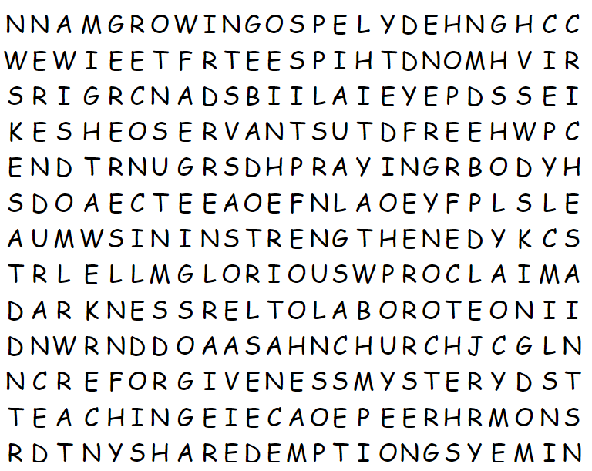
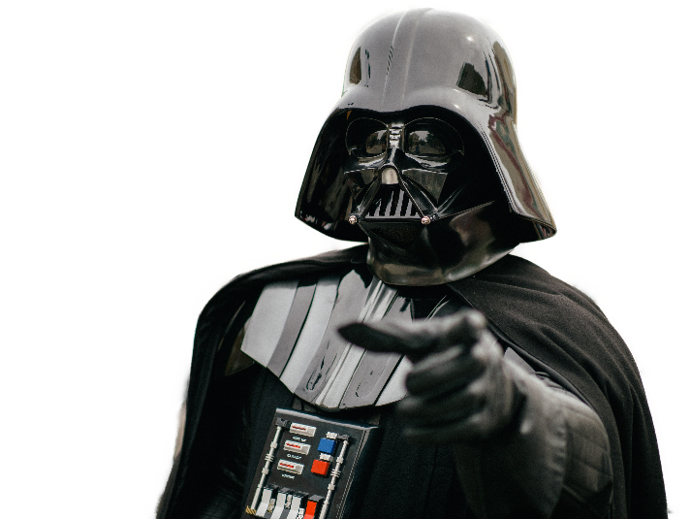
Family Activities
The Word Search Lady is not as forgiving as I am. It is your destiny, join me to find each word that came from your Bible Study. If you must, help is available at https://tinyurl.com/7uwhch9d You can also find the crossword … or the color page!

Slide 24
Growing in Christ
April 28

