Slide 1
Does It Call You to Trust God?
February 5

Slide 2
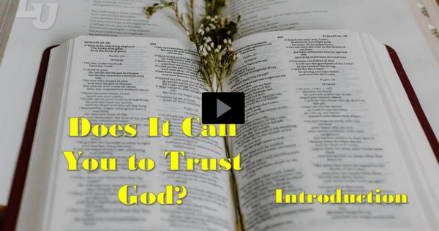
Video Introduction
View Video

Slide 3
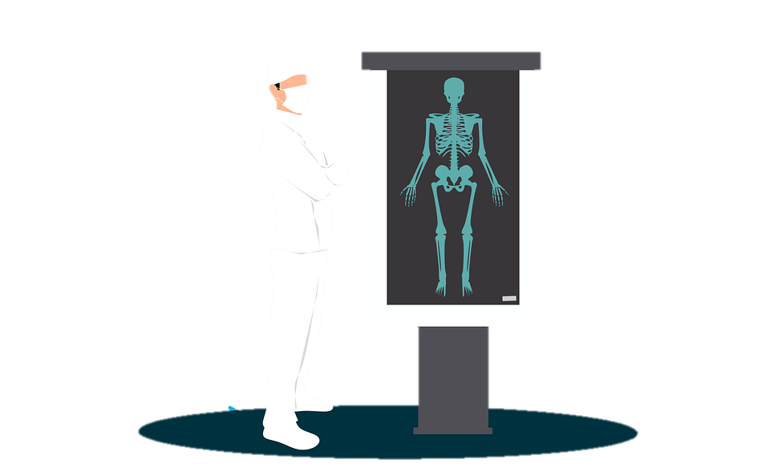
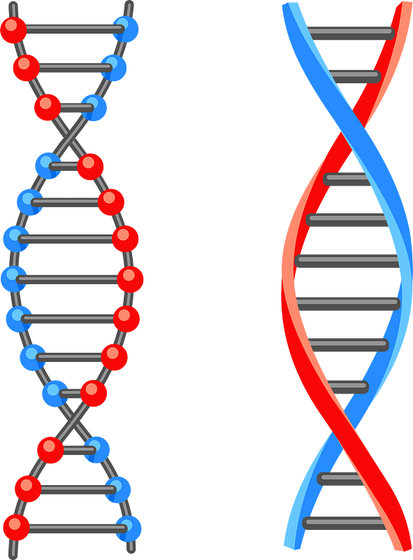
Think about this …
What are some things you can’t see but you know are there?
There are many important things we take on faith.
Everything God does in our lives is designed to increase our faith in Him.
Discerning and obeying God’s voice calls for faith in Him.

Slide 4
Listen for a definition of faith.
Hebrews 11:1-3 (NIV) Now faith is being sure of what we hope for and certain of what we do not see. 2 This is what the ancients were commended for. 3 By faith we understand that the universe was formed at God's command, so that what is seen was not made out of what was visible.

Slide 5
Believe and Rely on God
We see two basic elements:
The reality required for having hope
Evidence beyond what we see and feel
Identify the key words and phrases in the writer’s explanation of faith.
Note descriptive phrases in other Bible versions
NIV | KJV | NLT
Being sure of what we hope for Certain of what we do not see | Substance of things hoped for Evidence of things not seen | Confident assurance that what we hope for is going to happen Evidence of things we cannot yet see

Slide 6
Believe and Rely on God
What mighty act of God does the writer cite as an example of responding in faith to God?
How is that different than when we call an artist “creative”?
Why does believing God is Creator require faith on our part?

Slide 7
Believe and Rely on God
How can the creation around us fuel our faith in the unseen God?
What else, besides creation, compels you to have faith in God even though you’ve never seen Him? What are some experiences that have increased your faith in God?

Slide 8
Listen for names from the Hall of Fame of Faith.
Hebrews 11:4-6 (NIV) By faith Abel offered God a better sacrifice than Cain did. By faith he was commended as a righteous man, when God spoke well of his offerings. And by faith he still speaks, even though he is dead. 5 By

Slide 9
Listen for names from the Hall of Fame of Faith.
faith Enoch was taken from this life, so that he did not experience death; he could not be found, because God had taken him away. For before he was taken, he was commended as one who pleased God.

Slide 10
Listen for names from the Hall of Fame of Faith.
And without faith it is impossible to please God, because anyone who comes to him must believe that he exists and that he rewards those who earnestly seek him.

Slide 11
Faith Responds with Obedience
What proves that both Abel and Enoch pleased God?
Our passage says that Abel, “by faith he still speaks.” How does our influence as people of faith live long past us and affect those who follow us?

Slide 12
Faith Responds with Obedience
According to this passage, what is the only way we can please God with our lives?
What do you think it means to earnestly seek God?
Why is faith necessary for pleasing God?

Slide 13
Listen for aliens and strangers.
Hebrews 11:13-16 (NIV) All these people were still living by faith when they died. They did not receive the things promised; they only saw them and welcomed them from a distance. And they admitted that

Slide 14
Listen for aliens and strangers.
they were aliens and strangers on earth. 14 People who say such things show that they are looking for a country of their own. 15 If they had been thinking of the country they had left, they would have

Slide 15
Listen for aliens and strangers.
had opportunity to return. 16 Instead, they were longing for a better country--a heavenly one. Therefore God is not ashamed to be called their God, for he has prepared a city for them.

Slide 16
Focused on God’s Word
What was the fate of some of these heroes of faith?
What desire did the examples of faith have?
How would God honor that desire?
What kinds of things do we trust the Lord for but might not see happen while we are still in this life?

Slide 17
Focused on God’s Word
What has helped you remain faithful while waiting for God to fulfill a promise?
In what concrete ways can we demonstrate the truth that we are “aliens and strangers” on earth?

Slide 18
Application
Pray.
Consider the greatest challenge you are currently facing.
On a scale of one to ten, how would you rate your faith?
Pray each day, trusting God to help you with the challenging situation.

Slide 19
Application
List.
Make a list of as many promises of God in the Bible as you can think of.
Identify any promises you may have difficulty believing for your own life.
Pray and ask God to help you trust Him and claim those promises for your life.

Slide 20
Application
Encourage.
If you know others who are struggling with faith or with one of God’s promises, encourage their faith.
Pray for them and with them.
Remind them that God’s faithfulness in the past means He can be trusted with the future.

Slide 21
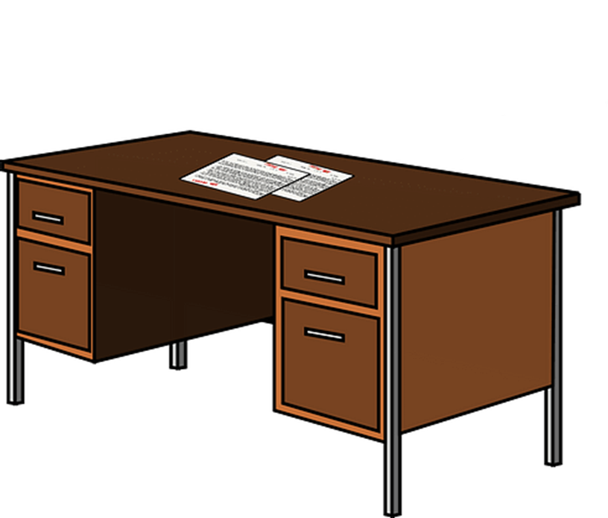
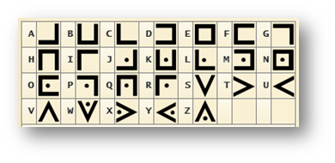
Family Activities
We have the key and now the message. Help us decode it. We trust that you can do it. Maybe you have a middle schooler to assist. Check for help at https://tinyurl.com/2cn2sd9f and other Family Activities.

Slide 22
Does It Call You to Trust God?
February 5

