Slide 1
A Life of Victory
April 10

Slide 2
Video Introduction
View Video

Slide 3
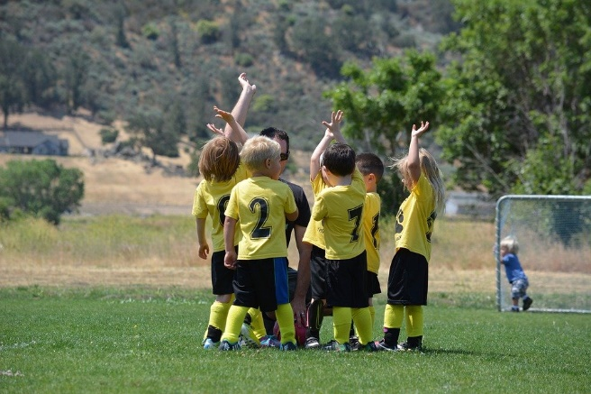
Brag a little …
Describe a victory you’ve experienced recently.
Some victories are surprises, some are hard earned.
Today we consider how in Christ, we can have victory over anything the world throws at us.

Slide 4
Listen for Jesus’ reassurance.
John 16:19-22 (NIV) Jesus saw that they wanted to ask him about this, so he said to them, "Are you asking one another what I meant when I said, 'In a little while you will see me no more, and then after a little while you will see me'? 20 I tell you the truth, you will weep

Slide 5
Listen for Jesus’ reassurance.
and mourn while the world rejoices. You will grieve, but your grief will turn to joy. 21 A woman giving birth to a child has pain because her time has come; but when her baby is born she forgets

Slide 6
Listen for Jesus’ reassurance.
the anguish because of her joy that a child is born into the world. 22 So with you: Now is your time of grief, but I will see you again and you will rejoice, and no one will take away your joy.

Slide 7
Jesus’ Resurrection Brings Joy
What human emotions did Jesus place in contrast, and who had which and why?
To what events does Jesus allude that would cause sorrow?
What did Jesus use to illustrate His point? Why is it appropriate?

Slide 8
Jesus’ Resurrection Brings Joy
What is the reassuring promise found in verse 22?
When have you seen a difficulty in life turn into something positive? What grief or sorrow in your life has God turned to joy?
What hope might this passage give you in times of sorrow?

Slide 9
Listen for a reminder of God’s love.
John 16:27-30 (NIV) No, the Father himself loves you because you have loved me and have believed that I came from God. 28 I came from the Father and entered the world; now I am leaving the world and going back to the Father."

Slide 10
Listen for a reminder of God’s love.
Then Jesus' disciples said, "Now you are speaking clearly and without figures of speech. 30 Now we can see that you know all things and that you do not even need to have anyone ask you questions. This makes us believe that you came from God."

Slide 11
Victory in Jesus
What truth about God did Jesus affirm?
What are two key elements in establishing a right relationship with God?

Slide 12
Victory in Jesus
What four statements about Himself did Jesus declare and what is their significance?
Jesus’ Assertions about Himself | Meaning – Significance
2.
3.
4.

Slide 13
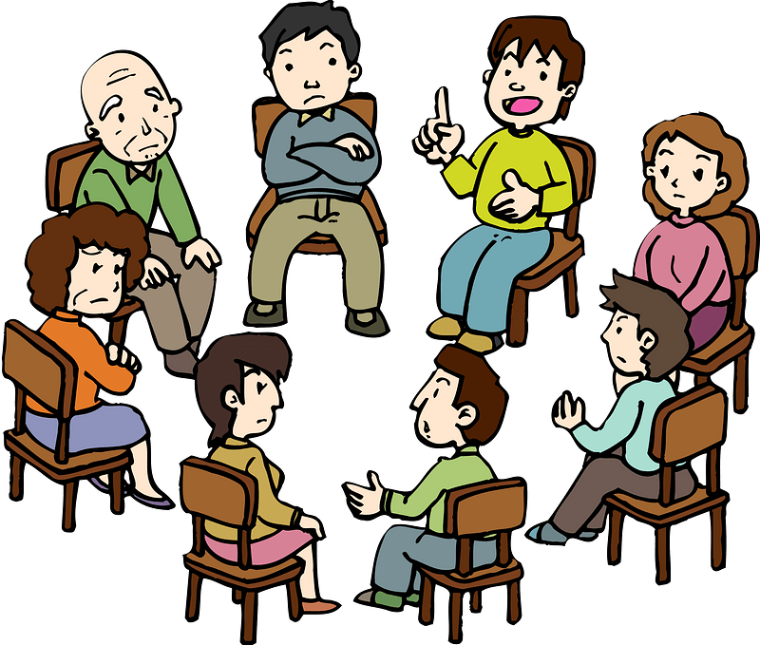
Victory in Jesus
Let me tell you about Jesus, the Son of God …
How do you respond to this person’s honest confusion?
I didn’t realize God was married.

Slide 14
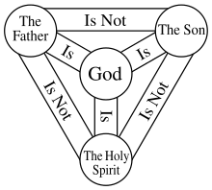
Victory in Jesus
The Trinity … God the Father, God the Son, and God the Holy Spirit
Three representations or personalities that help us understand what God is like

Slide 15
Victory in Jesus
God the Son
The person of God who came as a human, living in time and space … died, arose from death
God the Father
The person of God that was still in Heaven when Jesus was on the earth
God the Spirit
The person of God who dwells within believers

Slide 16
Listen for a final word of comfort.
John 16:31-33 (NIV) "You believe at last!" Jesus answered. 32 "But a time is coming, and has come, when you will be scattered, each to his own home. You will leave me all alone. Yet I am not alone,

Slide 17
Listen for a final word of comfort.
for my Father is with me. 33 "I have told you these things, so that in me you may have peace. In this world you will have trouble. But take heart! I have overcome the world."

Slide 18
Live in Peace and Courage
What was the message behind Jesus’ question in verse 31?
What did He use as an example to show they may not be as strong in the faith as they thought they were?
In what ways is verse 31 a strong concluding word for this discourse?

Slide 19
Live in Peace and Courage
What encouragement could the disciples have in the midst of life’s storms?
In what ways can you feel God’s presence in the midst of a difficult time?

Slide 20
Application
Memorize.
Set aside some time each day this week to memorize John 16:33: “I have told you these things so that in me you may have peace. You will have suffering in this world. Be courageous! I have conquered the world.”

Slide 21
Application
List.
Make a list of the difficulties and pains you are facing right now.
Ask Jesus to help you bear the load you carry.

Slide 22
Application
Help.
Ask God to make you aware of someone who is suffering right now.
How can you help them have peace and courage?
How can you remind them to trust Jesus? Take the initiative this week to reach out to this person

Slide 23
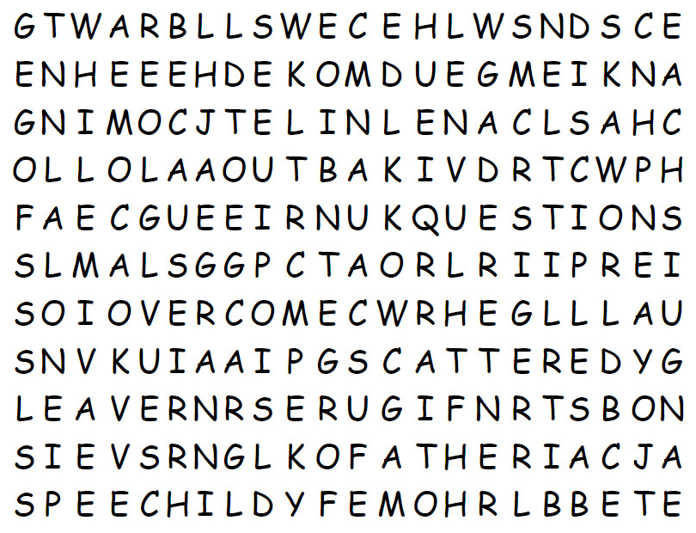
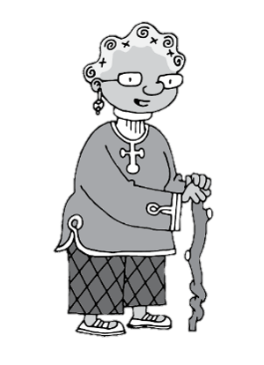
Family Activities
Well, I found one of the words. And I see two more in the bottom line. Can you find the rest? They are all words from our scripture passage. There’s help available at https://tinyurl.com/4nebb3rx And a color page and other engaging activities can also be found.

Slide 24
A Life of Victory
April 10

