Slide 1
Who Is Your Neighbor?
July 24

Slide 2
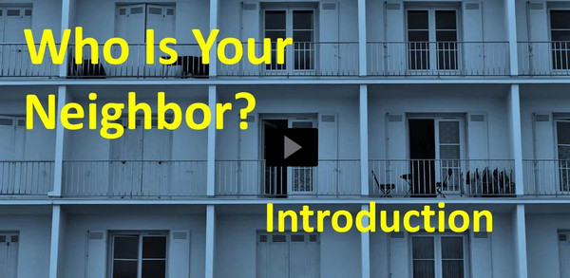
Video Introduction
View Video

Slide 3
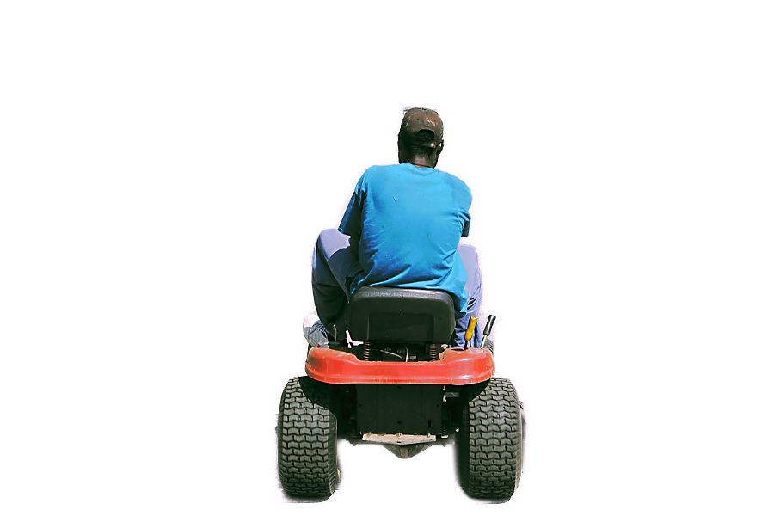
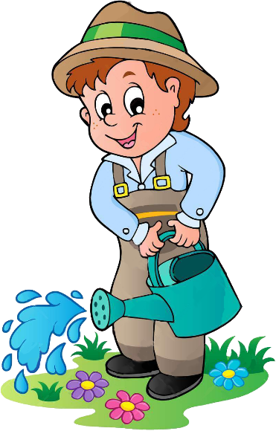
Remember how it was?
Growing up, what type of chore or school assignment would you do “just enough” to get by?
Love compels us to be the neighbor Jesus spoke of.
Today we look at how loving God will be demonstrated in how we love others.

Slide 4
Listen for how Jesus answers.
Luke 10:25-28 (NIV) On one occasion an expert in the law stood up to test Jesus. "Teacher," he asked, "what must I do to inherit eternal life?" 26 "What is written in the Law?" he replied. "How do you read it?" 27 He answered:

Slide 5
Listen for how Jesus answers.
"'Love the Lord your God with all your heart and with all your soul and with all your strength and with all your mind'; and, 'Love your neighbor as yourself.'" 28 "You have answered correctly," Jesus replied. "Do this and you will live."

Slide 6
Love for God ↔ Love for Others
What different motivations do people have for asking questions about God and of God?
The question asked of Jesus was “What must I do to inherit eternal life?” This question is arguably the most important question any person can ask !

Slide 7
Love for God ↔ Love for Others
Give your opinion why you think the lawyer was or was not sincere in asking it.
If it was not a sincere question, but a test … what kind of test do you think this was?
Note that Jesus responds with a question of His own (a good teaching technique). How did the legal expert summarize the demands of the Law?
Sincere | Not Sincere

Slide 8
Love for God ↔ Love for Others
What does it mean to “love your neighbor as yourself”?
What conditions do we sometimes put on giving love to one another?
This man was an expert on scripture and the Mosaic Law. How might spending too much time simply studying the Bible lead to an unbalanced spiritual life?
Actually, too many of us do not spend time in scripture – extremes in either direction (too little scripture study or too much only study) are unhealthy.

Slide 9
Listen for characters in Jesus’ parable.
Luke 10:29-32 (NIV) But he wanted to justify himself, so he asked Jesus, "And who is my neighbor?" 30 In reply Jesus said: "A man was going down from Jerusalem to Jericho, when he fell into the hands of robbers. They stripped him of his clothes, beat him

Slide 10
Listen for characters in Jesus’ parable.
and went away, leaving him half dead. 31 A priest happened to be going down the same road, and when he saw the man, he passed by on the other side. 32 So too, a Levite, when he came to the place and saw him, passed by on the other side.

Slide 11
Love Does Not Ignore Others
Why do you think the lawyer felt a need to justify himself? How do you understand the intent of his question “And who is my neighbor?”
Put yourself in the position of the priest or Levite. What would be the pros and cons of stopping to help this man?

Slide 12
Love Does Not Ignore Others
What natural inclinations make it easier for you to act like the priest and the Levite in the story than like the Samaritan? In what ways do we sometimes justify not helping others in need?
How do we overcome barriers like these?

Slide 13
Listen for who is the unlikely hero.
Luke 10:33-37 (NIV) But a Samaritan, as he traveled, came where the man was; and when he saw him, he took pity on him. 34 He went to him and bandaged his wounds, pouring on oil and wine. Then he put the man on his own donkey, took him to an inn and took care of him. 35 The next day he took out two silver coins and gave them to the

Slide 14
Listen for who is the unlikely hero.
innkeeper. 'Look after him,' he said, 'and when I return, I will reimburse you for any extra expense you may have.' 36 "Which of these three do you think was a neighbor to the man who fell into the hands of robbers?" 37 The expert in the law replied, "The one who had mercy on him." Jesus told him, "Go and do likewise."

Slide 15
Going Out of Your Way to Help
Why would a Samaritan be considered an unlikely hero in the story?
What all did the traveling Samaritan do for the injured man?
What attitude differentiated the Samaritan’s response from that of the priest and Levite?

Slide 16
Going Out of Your Way to Help
What can we intentionally do as individual Christians or as a church to help remove the attitudes that prevent God’s love and message of compassion from reaching all people?

Slide 17
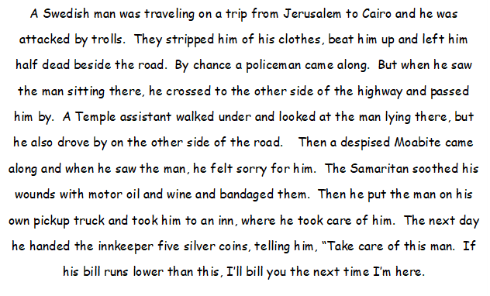
Family Activities
Something is wrong with this story. It looks like some incorrect words got stuck in there. Maybe friends from our church Bible study can help us. We might also look at https://tinyurl.com/ekrx3jhhf for more fun things to do

Slide 18
Who Is Your Neighbor?
July 24

