Slide 1
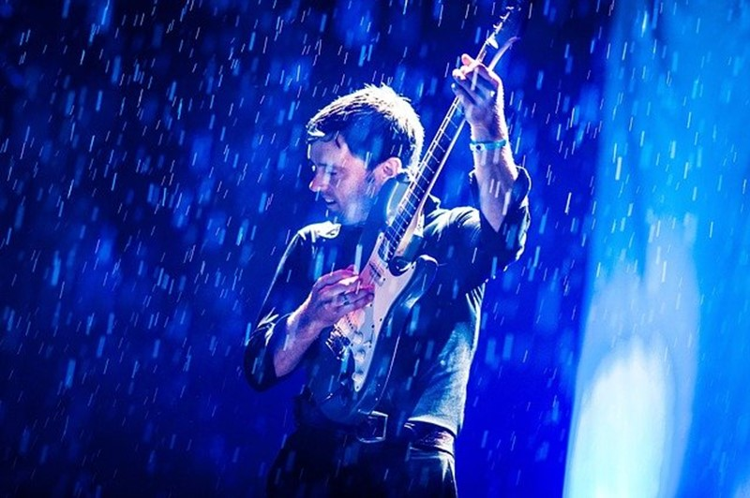
Weathering the Blues
January 10

Slide 2
Video Introduction
View Video

Slide 3
Admit it, now …
When have you felt like singing the blues?
Many things in these unprecedented times can cause us to “feel blue” or send us into a “blue funk”
But we can cling to the reality that God will us up when we feel down.

Slide 4
Listen for David’s plea.
Psalm 31:1-2 (NIV) In you, O LORD, I have taken refuge; let me never be put to shame; deliver me in your righteousness. 2 Turn your ear to me, come quickly to my rescue; be my rock of refuge, a strong fortress to save me.

Slide 5
Problems and Concerns
In whom did David affirm his trust
What words or phrases did he use to describe what he desired for the Lord to be for him during this life situation?
What is the background for the imagery? What do you know about the problems for which David would have needed God’s rescue?

Slide 6
Problems and Concerns
What are some circumstances that tend to bring you down?
How do complaint and blame do nothing for one's situation and can even make the it worse?
How do David’s words give us hope in our distress?

Slide 7
Listen for specific ways God rescues.
Psalm 31:3-4 (NIV) Since you are my rock and my fortress, for the sake of your name lead and guide me. 4 Free me from the trap that is set for me, for you are my refuge.

Slide 8
Take Your Concerns to God
Once again, David refers to God as a rock, his refuge and fortress. Why do you suppose David is repeating himself?
What is stated in verse 4 that may be a hint of what was causing his emotional upheaval?
What are some secret nets or traps we fall prey to?

Slide 9
Take Your Concerns to God
What are some ways that God sends help when we turn to Him for rescue from traps, snares, and the enemies’ attacks?

Slide 10
Listen for David’s response.
Psalm 31:5-8 (NIV) Into your hands I commit my spirit; redeem me, O LORD, the God of truth. 6 I hate those who cling to worthless idols; I trust in the LORD. 7 I will be glad and rejoice in your love, for you saw my affliction and knew the anguish of my soul. 8 You have not handed me over to the enemy but have set my feet in a spacious place.

Slide 11
Trust God to Carry You Through
What additional affirmations of trust are found in verse 5?
What were some of the manifestations of God’s mercy the psalmist identified in verses 7-8?
Whereas he had the blues over his circumstances in life, what emotions characterized his disposition upon thinking about God’s mercy?

Slide 12
Trust God to Carry You Through
Where does our culture encourage us to put our trust when we need protection?
What are some words that describe how you feel to know that God sees your affliction and knows the troubles of your soul?

Slide 13
Application
Worship.
Trust is expressed as you worship because it keeps you focused on Christ.
Make the decision to actively engage in worship both with your church and in your private devotional life.

Slide 14
Application
Study.
Identify Bible verses that teach what God says about the issue of depression and sadness in our lives
Then you can share them with others.

Slide 15
Application
Seek help.
Do a serious personal evaluation about what causes depression in your life.
Admit that it is real and it is serious.
It might be time to talk with a close friend, pastor, or counselor about it.

Slide 16
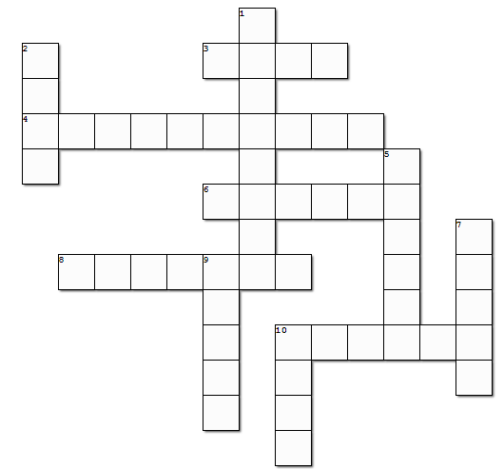
Family Activities
Humph! How are you supposed to solve a clueless crossword? If you’re given the words, how does that help? My sister says “count the words.” Bet she’s as clueless as this puzzle. Well she says there’s help at https://tinyurl.com/ycurljdu and there are other possible educational activities. Humph! Double credit on your book reports if you complete all of them!

