Slide 1
We Are Joined Together
July 26

Slide 2
Video Introduction
View Video

Slide 3
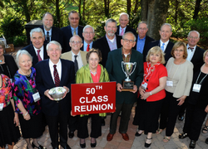
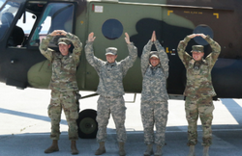
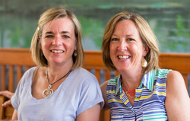
Think about it …
When have you felt most at home with a group of people?
For people who have come to faith in Christ we belong to a unique group
Not only are we members of a local congregation …
We also become a part of the Body of Christ – that group of believers the world over.

Slide 4
Listen for Christ’s relationship to the Church.
Ephesians 1:20-23 (NIV) which he exerted in Christ when he raised him from the dead and seated him at his right hand in the heavenly realms, 21 far above all rule and authority, power and dominion, and every title that can be given,

Slide 5
Listen for Christ’s relationship to the Church.
not only in the present age but also in the one to come. 22 And God placed all things under his feet and appointed him to be head over everything for the church, 23 which is his body, the fullness of him who fills everything in every way.

Slide 6
Christ Head of the Church
What two events related to Christ does Paul cite to describe the greatness of God’s power given to those who believe?
Over what realms and for what times has Christ been exalted?
What does it mean for Christ to be head over all things to the church?

Slide 7
Christ Head of the Church
If Christ is the head and the church is His body, what implications does that have for how the church functions?
How is being a part of a church different from being a part of any other organization?
What happens when we forget that Christ is the head of the church?

Slide 8
Christ Head of the Church
How does the knowledge of God’s authority and control make you secure?
How can we make Christ the Head of our lives as individuals?
When the Spirit of Christ fills our lives, how will our lives be different?

Slide 9
Listen for God’s gift.
Ephesians 2:8-10 (NIV) For it is by grace you have been saved, through faith--and this not from yourselves, it is the gift of God-- 9 not by works, so that no one can boast. 10 For we are God's workmanship, created in Christ Jesus to do good works, which God prepared in advance for us to do.

Slide 10
God’s Grace
List the critical words you see in verse 8.
How do they relate to each other in the salvation experience?
For what purpose have we been saved?

Slide 11
God’s Grace
What do these verses teach us about God’s grace?
Why is it important for us to know that we are God’s workmanship, God’s work of art?

Slide 12
Listen for who we are in Christ.
Ephesians 2:19-22 (NIV) Consequently, you are no longer foreigners and aliens, but fellow citizens with God's people and members of God's household, 20 built on the foundation of the apostles and prophets, with Christ Jesus himself as

Slide 13
Listen for who we are in Christ.
the chief cornerstone. 21 In him the whole building is joined together and rises to become a holy temple in the Lord. 22 And in him you too are being built together to become a dwelling in which God lives by his Spirit.

Slide 14
Members Together in God’s Household
What images did Paul use to describe the union of all believers in Christ?
Whom does he identify as the foundation of God’s holy building?
What do you think is the significance of Christ as the corner stone?

Slide 15
Members Together in God’s Household
What can we do to continually align ourselves with Christ, the Cornerstone?
Consider the importance of “fitting together” of different elements of the structure of a building … prevents leaks, shifting, collapse. What kinds of attitudes or actions sometimes need to be adjusted in our lives so that we “fit together” with other believers?

Slide 16
Application
Confess.
Adopt a right mindset of your part in Christ’s church.
Confess any wrong attitudes you hold (or have previously held) about individuals in your local church.

Slide 17
Application
Submit.
Read Ephesians 1:20-23 again and reflect upon the power and authority of Jesus Christ.
Submit your life to His authority and control

Slide 18
Application
Commit.
If you’re not a member of a local church, pursue membership to begin experiencing the beauty of living together” in the household of God.
This might mean going through a membership class or talking to a pastor.
If you’re already a member, commit yourself anew to the covenant and mission of your church.

Slide 19
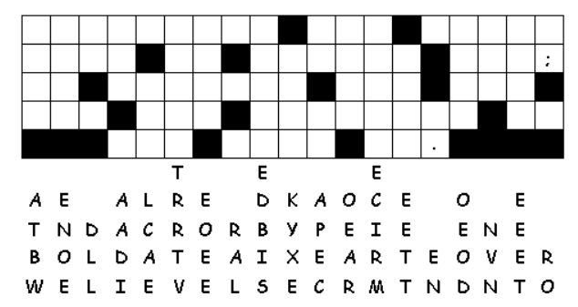
Family Activities
Well, look at that … it’s the Fallen Phrases puzzle. Let’s JOIN TOGETHER to solve it. And there’s more cool things to do for your family at https://tinyurl.com/yb644nc4

Slide 20
We Are Joined Together
July 26

