Slide 1
Our Commission
April 25

Slide 2
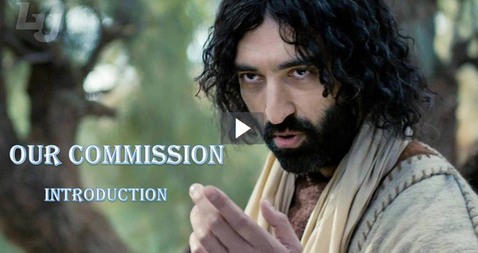
Video Introduction
View Video

Slide 3
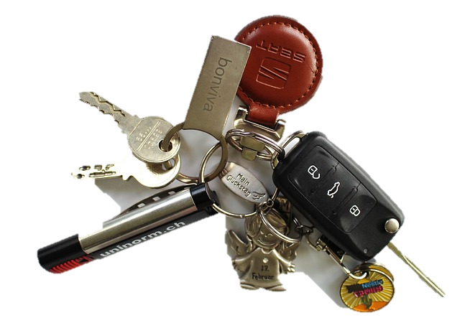
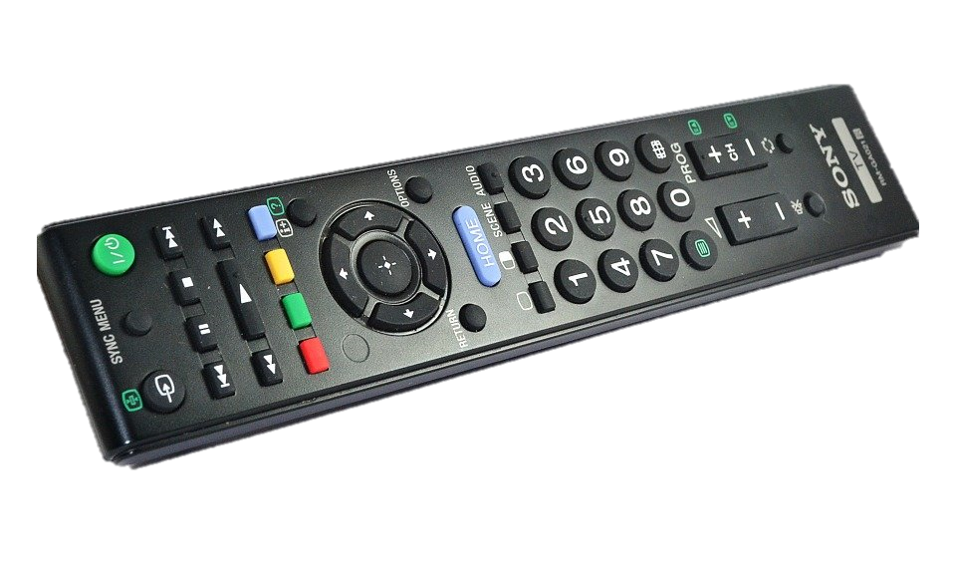
Where was it?
When was the last time you felt like you were on a mission to find something?
God has sent us on a mission.
God sends us to tell others about Jesus.
We are on mission with Jesus to share Good News that changes lives.

Slide 4
Listen for Christ’s challenge to His disciples.
Matthew 28:18-20 (NIV) 18 Then Jesus came to them and said, "All authority in heaven and on earth has been given to me. 19 Therefore go and make disciples of all nations, baptizing them in the name of the

Slide 5
Listen for Christ’s challenge to His disciples.
Father and of the Son and of the Holy Spirit, 20 and teaching them to obey everything I have commanded you. And surely I am with you always, to the very end of the age."

Slide 6
Christ’s Commission
What did Jesus say about Himself?
What does it mean to us that Jesus has “all authority”?
What activities were the disciples to be involved in?
To whom was Jesus speaking when He first spoke these words?

Slide 7
Christ’s Commission
Why is the commission transferable to other believers through the ages?
Note: The “go” is an imperatival participle in the original Greek.
Read “as you are going”
As you go about life
The imperative is strong … we are commanded to go into all the world, to every nation

Slide 8
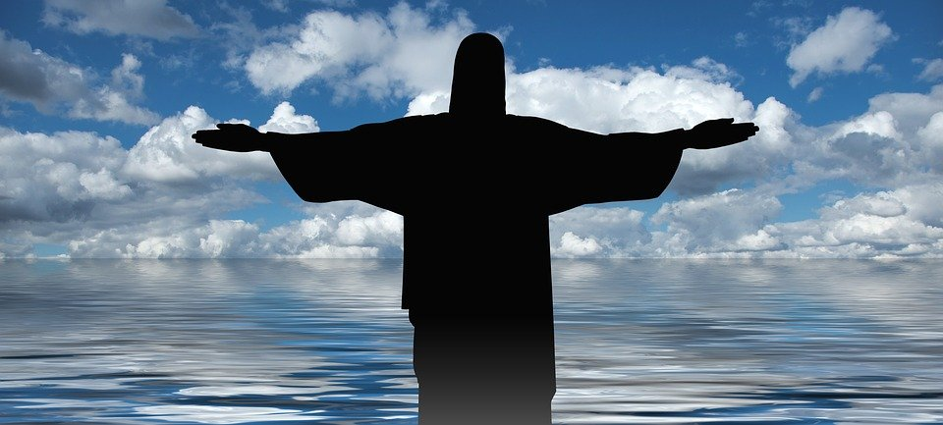
Christ’s Commission
How can knowing that Jesus is always with us make a difference “as we are going”?

Slide 9
Listen for what is new.
2 Corinthians 5:16-19 (NIV) So from now on we regard no one from a worldly point of view. Though we once regarded Christ in this way, we do so no longer. 17 Therefore, if anyone is in Christ, he is a new creation; the old has gone, the new has come!

Slide 10
Listen for what is new.
All this is from God, who reconciled us to himself through Christ and gave us the ministry of reconciliation: 19 that God was reconciling the world to himself in Christ, not counting men's sins against them. And he has committed to us the message of reconciliation.

Slide 11
Tell of Christ’s Work in Our Lives
What is the “worldly point of view” Paul mentions?
What did God do through Christ?
In what ways does God change our lives, make us a new “creation”?

Slide 12
Tell of Christ’s Work in Our Lives
To what responsibility have we been appointed on behalf of Christ?
How can you personally be involved in the ministry of reconciliation?

Slide 13
Listen for the role to which we are appointed.
2 Corinthians 5:20-21 (NIV) We are therefore Christ's ambassadors, as though God were making his appeal through us. We implore you on Christ's behalf: Be reconciled to God. 21 God made him who had no sin to be sin for us, so that in him we might become the righteousness of God.

Slide 14
Ambassadors for Christ
What appeal was part of Paul’s message to the Corinthians?
To what position have we been appointed in relation to sharing the message of reconciliation?
What are some ways we act as ambassadors for Christ? How is a Christian an ambassador?

Slide 15
Ambassadors for Christ
The lyrics of a Gospel song declare that believers are the only “Jesus” that some will ever see. What kinds of things in the life of a believer would keep others from seeing Jesus in their lives?
What steps can we take so people will be attracted to Jesus more clearly, so we are better ambassadors?

Slide 16
Application
Thank Him.
Thank God for His authority
Express thanks for the commission He’s entrusted to you to represent Him and share His good news.

Slide 17
Application
Trust Him.
We can overcome fears by giving them over to God.
If you’re challenged with sharing Jesus with others, pray and trust God to reveal and heal these areas.
Acknowledge and write down any fears, concerns, or needs you want Him to help you overcome.
Pray and trust Him to move.

Slide 18
Application
Tell of His love.
As you meet people during the week, be bold.
Ask, “Has anyone told you Jesus loves you?”
Tell them, “He does and I just wanted to let you know.”

Slide 19
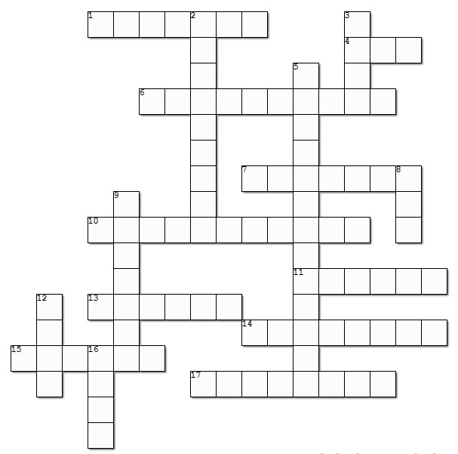
Family Activities
I’m so glad to see the Crossword. I just can’t do those mixed up word things. And the Wordsearch Lady … HUMPH! But, if you like those Fallen Phrases or want a coloring page or family discussion, go to https://tinyurl.com/3mzw8kfj

Slide 20
Our Commission
April 25

