Slide 1
Knowing God
January 31

Slide 2
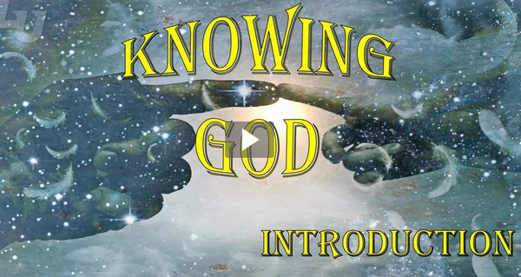
Video Introduction
View Video

Slide 3
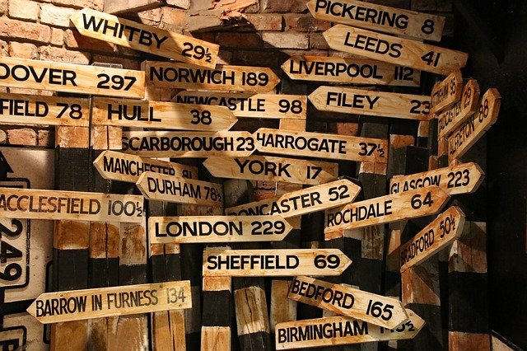
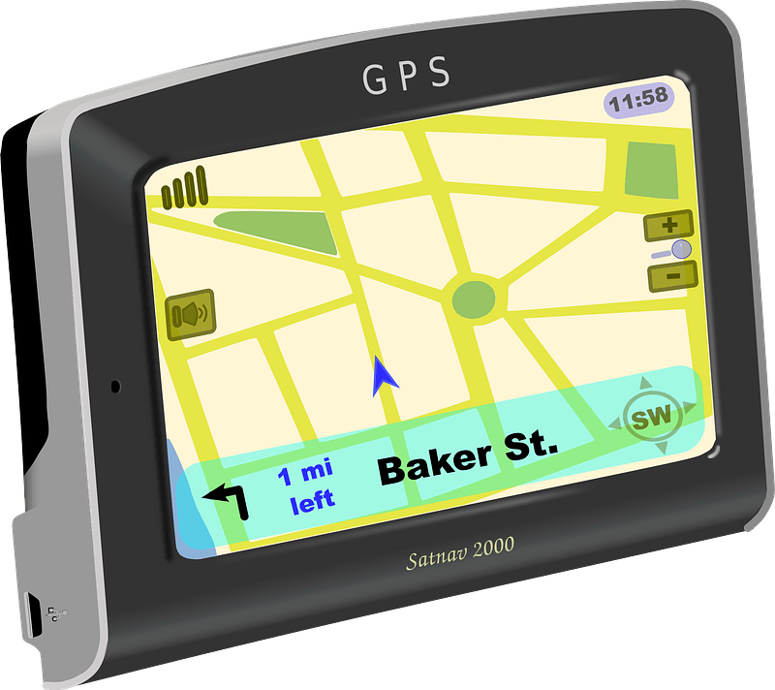
Remember that time?
When have you heard of bad directions or instructions leading someone astray?
Misdirection can be very serious.
It’s important to know the right way to go.
We will know the right way as we encounter God and His direction through His Word.
Turn around when possible ...

Slide 4
Listen for prayer requests.
Psalm 119:17-18 (NIV) Do good to your servant, and I will live; I will obey your word. 18 Open my eyes that I may see wonderful things in your law.

Slide 5
Encountering God through Scripture
What is the request in verse 17 and why does the psalmist desire that the Lord respond to it?
What is the earnest request in verse 18?
Why did the psalmist consider that to be an important request for God to answer?
What helps us hear God’s voice above all the other distracting voices in this life?

Slide 6
Encountering God through Scripture
When has God opened your eyes to reveal Himself to you in a fresh way through His Word?

Slide 7
Listen for how to face opposition.
Psalm 119:19-22 (NIV) I am a stranger on earth; do not hide your commands from me. 20 My soul is consumed with longing for your laws at all times. 21 You rebuke the arrogant, who are cursed and who stray from your commands. 22 Remove from me scorn and contempt, for I keep your statutes.

Slide 8
God’s Word Helps Us Face Opposition
What appeal did he make of the Lord?
How did the psalmist describe himself in relationship to his living in this world?
On what basis did the psalmist ask God’s intervention in removing reproach and contempt.
Who are the proud, the arrogant?

Slide 9
God’s Word Helps Us Face Opposition
What is God’s disposition toward the proud?
When have you felt like an outsider in this world?
How might being exposed to more of the Lord’s Word help the psalmist (and you) live as a stranger in the earth?
What was the psalmist’s overwhelming desire concerning the judgments of the Lord?

Slide 10
Listen for God’s perspective.
Psalm 119:23-24 (NIV) Though rulers sit together and slander me, your servant will meditate on your decrees. 24 Your statutes are my delight; they are my counselors.

Slide 11
God’s Word Gives God’s Perspective
How did he respond to those who slandered him? What did the psalmist say the Lord’s Word was for him during his challenging times?
What challenges do we face in bringing God’s perspective to bear in our lives?

Slide 12
God’s Word Gives God’s Perspective
What role should God’s Word play in our lives?
What strategies have helped you meditate on God’s Word?

Slide 13
Application
Read the Bible.
If you’re not spending time in God’s Word, start here and now.
Spend at least fifteen minutes every day reading God’s Word.

Slide 14
Application
Study the Bible.
Choose a book of the Bible and spend time studying its message.
Your pastor or group leader can recommend a commentary or study helps to assist you in your study.

Slide 15
Application
Meditate on God’s Word.
Turn off the TV, computer, and smartphone and spend uninterrupted time meditating on God’s Word.
Journal your thoughts and observations.

Slide 16
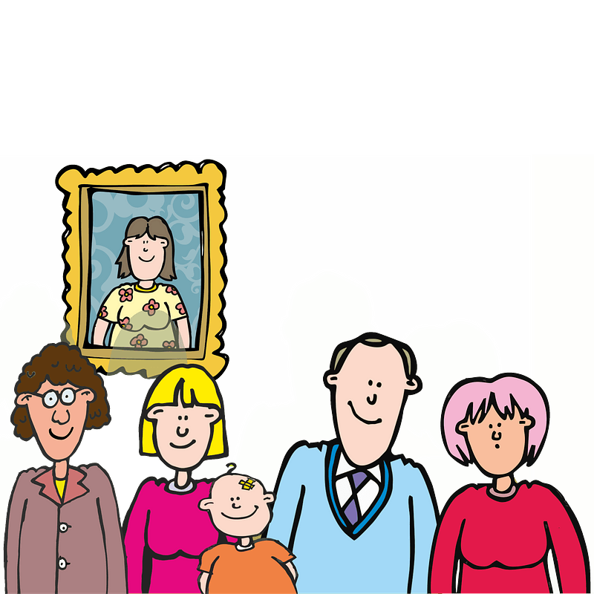
Family Activities
I know what Grandma would say …
It’s a BIG MESS
It’s an important message.
It’s tragic … all the letters fell down
Find help (and other Family Activities) at https://tinyurl.com/yxsk4acq

Slide 17
Knowing God
January 31

